Slide 1
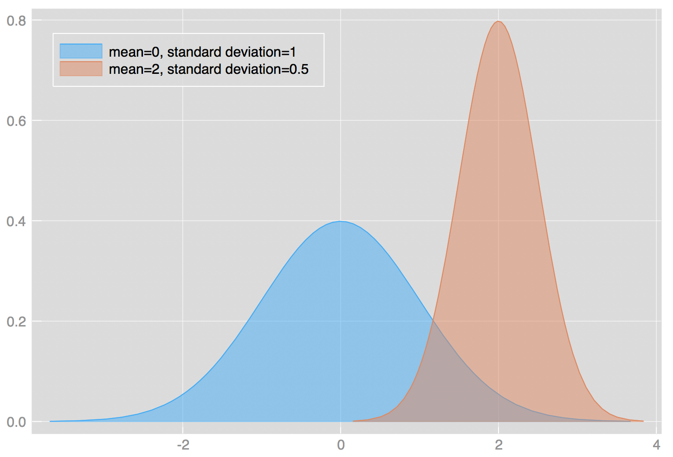
Week 6: Probability and Z/T scores
Geog4300: Shannon

Slide 2
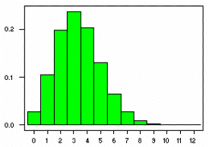
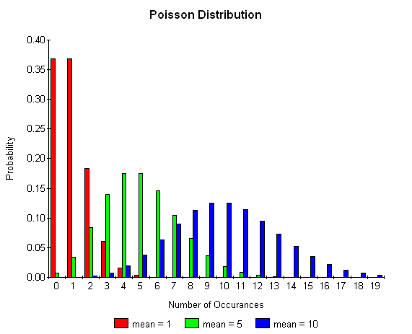
This week
Binomial/Poisson probability distributions
Z scores and T scores

Slide 3
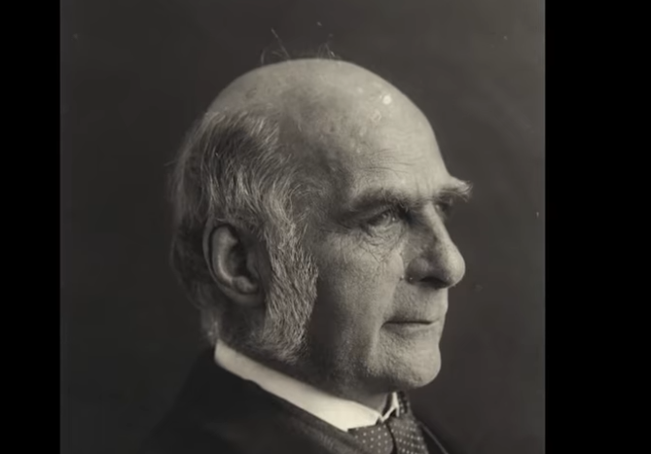
Let’s talk about the social history of statistics…
Francis Galton
https://www.youtube.com/watch?v=JeCKftkNKJ0

Slide 4
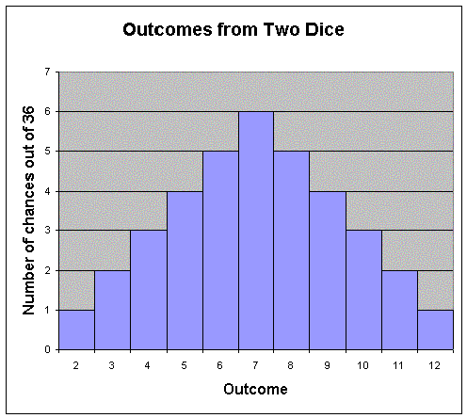
Probability distributions
How likely was an observed outcome?

Slide 5

Why do we care about probability?
Because statistical analysis is largely about whether an outcome could have happened by chance.

Slide 6

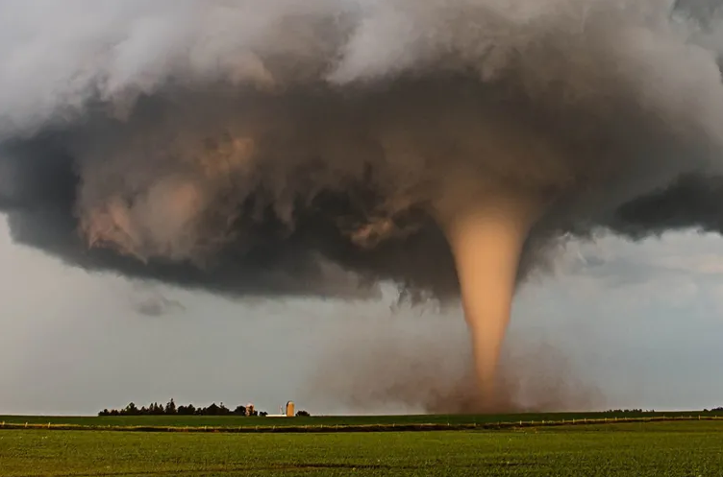
Binomial distribution:
How many “successes” in a set number of trials?
Poisson distribution:
How many times will a given event occur randomly over a period of time?

Slide 7
Binomial distribution
n! p^{x} q^{n-x}
P(x) =
x! (n-x)!
X= # of “successes”
N= # of trials
P = probability of success
q = probability of failure

Slide 8
Binomial distribution
Dice roll probabilities
2 | 1/36 (2.778%)
3 | 2/36 (5.556%)
4 | 3/36 (8.333%)
5 | 4/36 (11.111%)
6 | 5/36 (13.889%)
7 | 6/36 (16.667%)
8 | 5/36 (13.889%)
9 | 4/36 (11.111%)
10 | 3/36 (8.333%)
11 | 2/36 (5.556%)
12 | 1/36 (2.778%)
Let’s all roll our dice once.
How do the observed outcomes match up with the probabilities?

Slide 9
Binomial distribution
Dice roll probabilities
2 | 1/36 (2.778%)
3 | 2/36 (5.556%)
4 | 3/36 (8.333%)
5 | 4/36 (11.111%)
6 | 5/36 (13.889%)
7 | 6/36 (16.667%)
8 | 5/36 (13.889%)
9 | 4/36 (11.111%)
10 | 3/36 (8.333%)
11 | 2/36 (5.556%)
12 | 1/36 (2.778%)
n! p^{x} q^{n-x}
P(x) =
x! (n-x)!
x = # of “successes”
n = # of trials
p = probability of success
q = probability of failure
What’s the probability that you will roll a 4 or less zero, one, or two times in 3 rolls?

Slide 10
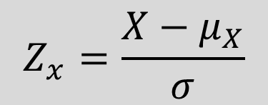
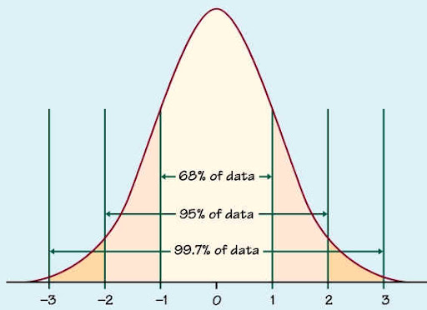

Z (and t) scores
How many standard deviations is an observation from the mean?
For a variable with a mean of 23 and a s.d. of 4, the z-score for 30 would be:
$$\frac{30 −23}{4}=1.75$$
What value would produce a z-score of negative 2?

Slide 11
Data challenge!
Pick a variable from our county census dataset. Transform its values to z-scores. How many counties are above 2? How many below -2? In what states/regions are these located?

